Slide 2


Slide 3


LineoAI

Slide 4


Slide 5

LineoAI

Slide 6

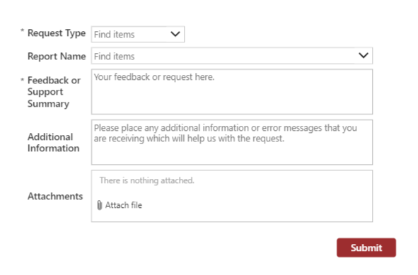
LineoAI
We would love to hear from you!
Support Request
If you have any access issues or our report is not working, please log it in this form and we will respond to you
General Feedback
Your feedback and thoughts about using LineoAI is valuable to us. Please write any comments that will help us to improve it.

Slide 7
LineoAI

